Slide 1

Presentation 2024
CUSTOMER CHURN
PREDICTION

Slide 2


Content
01
Introduction
02
Overview
03
Data Preprocessing
04
Exploratory Data Analysis
05
Feature Engineering
06
Model Evaluation
07
Best Model
08
Model Interpretation (shap)
09
SQL
10
Model Deployment

Slide 3


INTRODUCTION
Churn prediction is the process of identifying the clients who are most likely to stop using a service or to cancel their subscription. For many firms, this is an important prediction because it is difficult to get new customers than to keep existing ones.
WHY CHURN PREDICTION IS IMPORTANT ?
A way to improve products or services.
Understanding churn helps in retaining valuable customers.
Improves customer satisfaction.
Increases overall profitability.

Slide 4

OVERVIEW
The aim of this project is to determine how various factors including gender,partner, dependents, tenure, account information, services etc affect customer churn and then develop a predictive model to identify customers who are likely to churn, and manage the data using SQL.
DATA DESCRIPTION
Services Subscribed by Customers :[Phone Service ,Multiple Lines,Internet Service,Online Security,Online Backup,Device Protection,Tech Support,Streaming TV,Streaming Movies]
Customer Demographics :[Partner,Dependents,Senior Citizen,Gender]
Account Information :[Tenure ,Contract ,Payment Method,Paperless,Billing,Monthly Charges,Total Charges]

Slide 5
Data Preprocessing
1)
2)
Checking for duplicates:
There were no duplicates in the dataset.
Checking for missing values:
There were no missing values in the dataset.
3)
4)
Checking for data types:
All the columns were assigned correct data types
All column names have been converted to lowercase for consistency.
5)
6)
Changing the senior citizen column to categorical as the values are 1 or 0
Dropping the customer ID as it does not contain any meaningful insights.

Slide 6

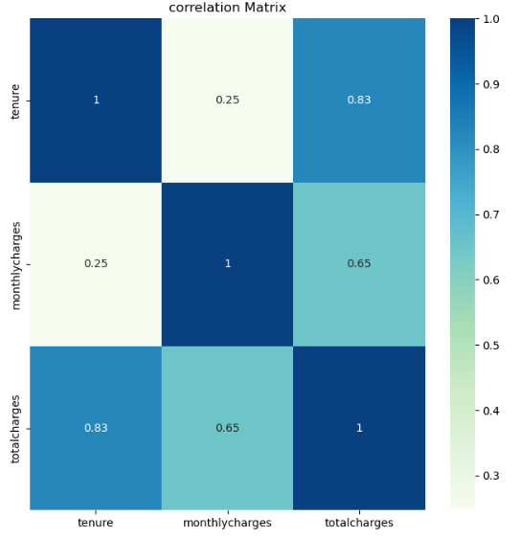
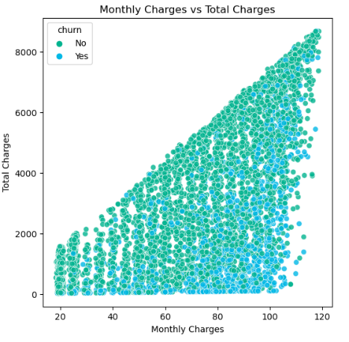
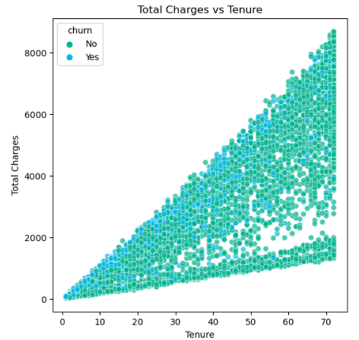
Exploratory Data Analysis
INSIGHTS
Monthly charges and total charges are moderately co-related.
Tenure and total charges are strongly co-related.
The scatter plot shows a positive linear relationship.
The higher the monthly charges, the higher the total charges.
The scatter plot shows a positive linear relationship between the total charges and tenure.
The longer the tenure, the higher the total charges customers pay.

Slide 7

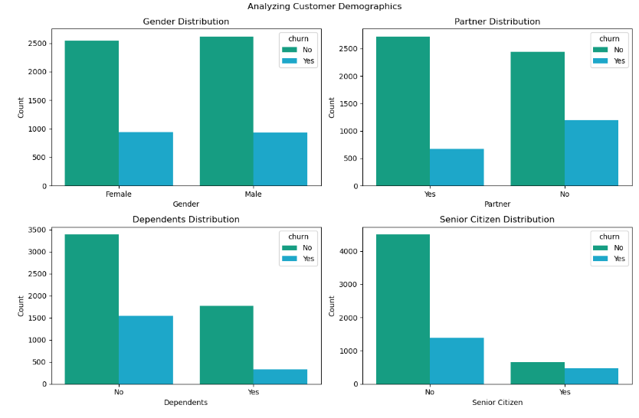
Analyzing Customer Demographics
INSIGHTS
Customers who dont have dependents are likely to churn.
Similarly,customers who dont have partners are likely to churn as well.
The churn rate for males and females is quite similar.
Younger people tend to churn more.

Slide 8

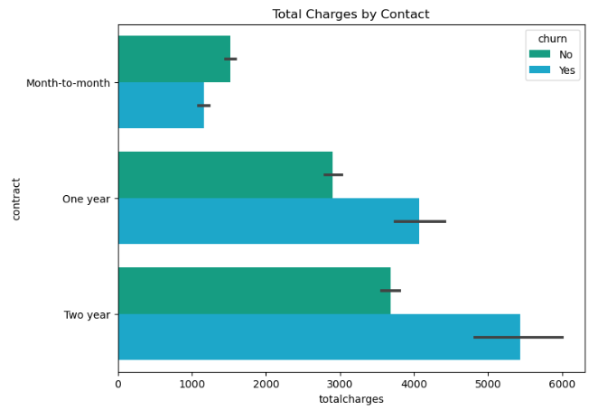
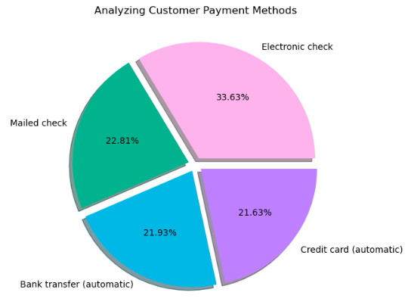
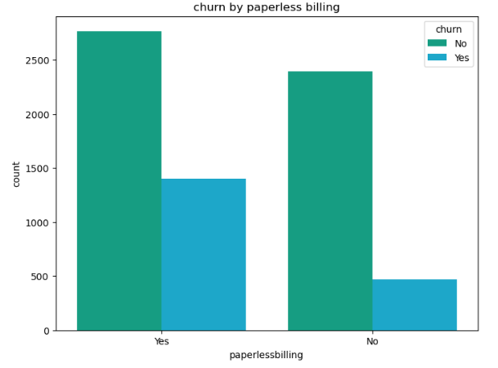
ANALYZING CUSTOMER ACCOUNT INFORMATION
INSIGHTS
INSIGHTS
INSIGHTS
The total charges tend to be more of yearly contracts.
The customers with yearly contracts are at more risk of churning.
The customers prefer to pay through electronic check more followed by mailed check.
The customer tend to churn more when they recieve their bills electronically.
More customers prefer to use paperless billing.

Slide 9
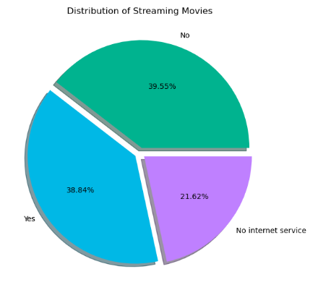
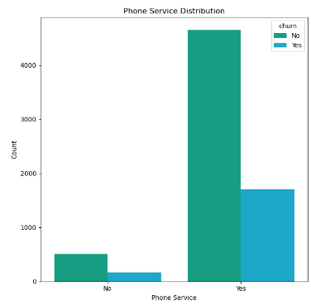
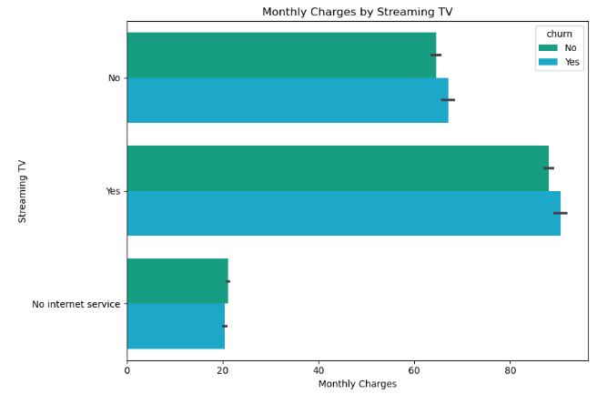
ANALYZING CUSTOMER SERVICES
INSIGHTS
INSIGHTS
INSIGHTS
Customers who stream movies and those who dont are almost evenly split with only a slight difference.
About 21.62% of customers dont have internet serivce to stream movies.
The monthly charges tend to be more of customers who stream tv.
The montlhy charges tend to be less of customers who dont have internet service to watch tv.
The customers having phone as services are less likely to churn.

Slide 10

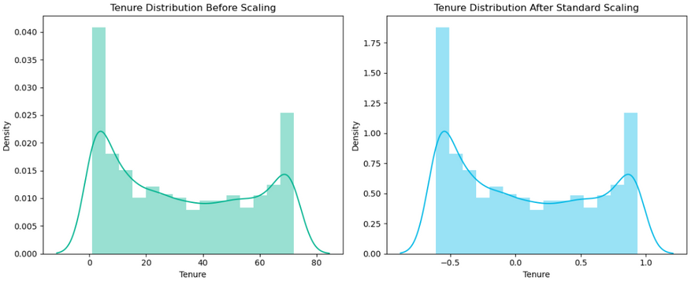

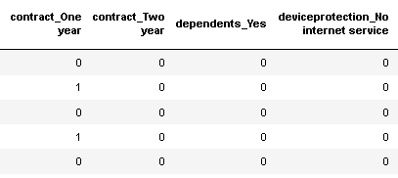
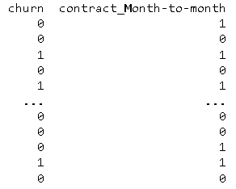

Feature Engineering
Feature Scaling
Used standard Scalar to standardize the features
One Hot Encoding
I have used One hot encoding to convert categorical input features to numerical
Label Encoding
1st Quarter
I have used Label encoding for target feature
List a milestone or deadline.

Slide 11
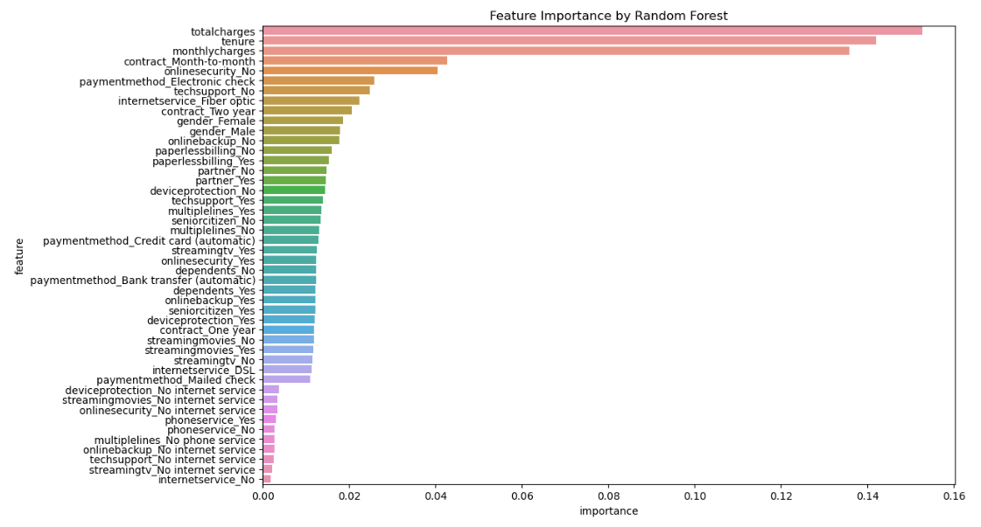
Feature Importance
The top ten features are:
totalcharges,tenure,monthlycharges,contract,onlinesecurity,paymentmethod,techsupport,internetservice,contract,gender.

Slide 12
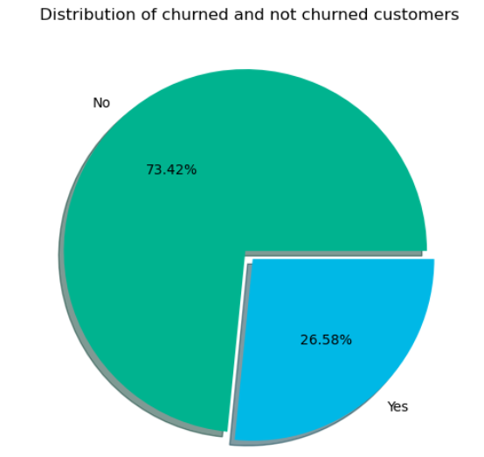
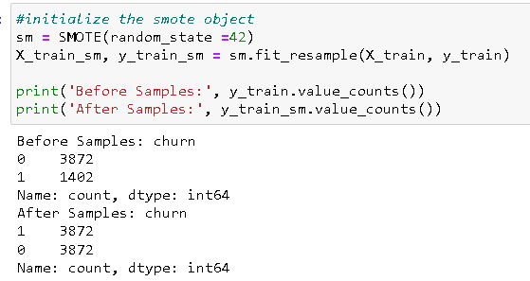
CLASS IMBALANCE
Class imbalance occurs when one class outnumbers the samples of other class.I have applied smote as the dataset is quite small and undersampling might lead to loss of information .

Slide 13
CROSS VALIDATION
Stratified K-fold Cross Validation is useful for imbalanced datasets to maintain representative class proportions in each training and validation fold.
This process is repeated k times and each time a different fold is used as a validation set.
CV RESULTS:

Slide 14
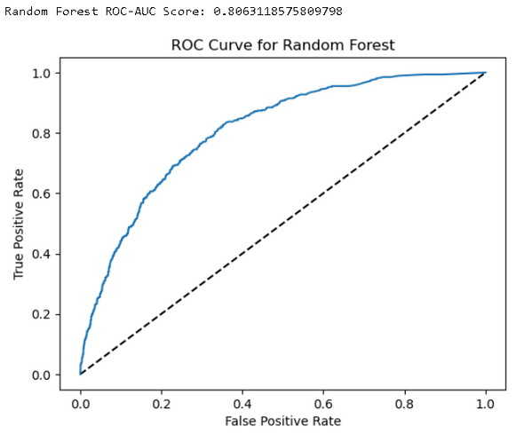
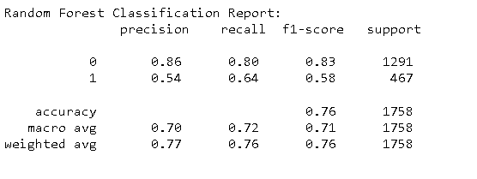
Model Evaluation
Random Forest
Best Estimators,Parameters and score
Classification Report
ROC CURVE

Slide 15
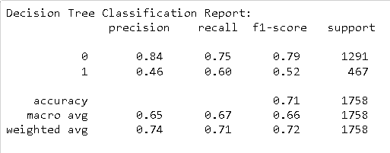
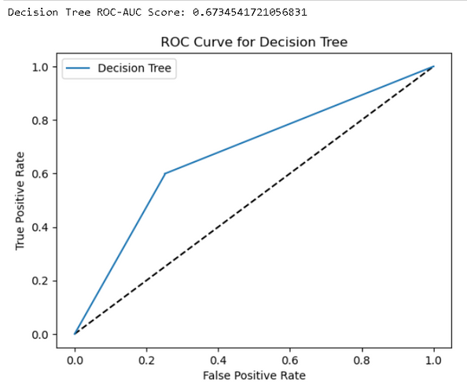
Model Evaluation
Decision Trees
Best Estimators,Parameters and score
Classification Report
ROC CURVE

Slide 16
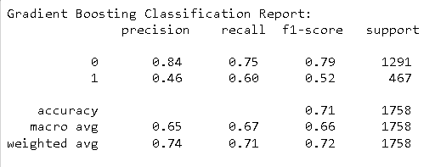
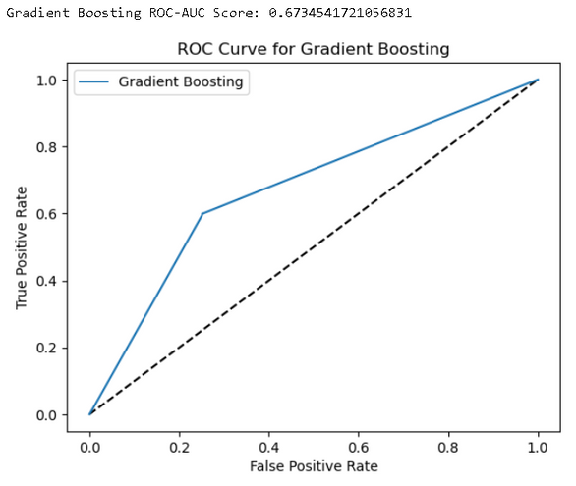
Model Evaluation
Gradient Boosting
Best Estimators,Parameters and score
Classification Report
ROC CURVE

Slide 17
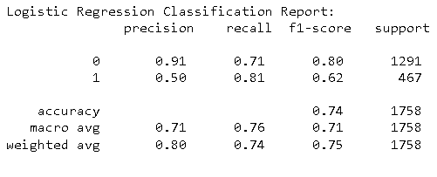
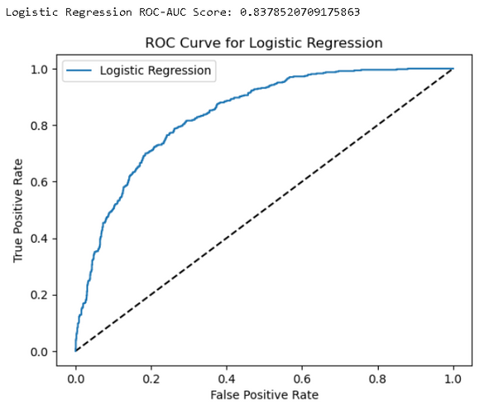
Model Evaluation
Logistic Regression
Best Estimators,Parameters and score
Classification Report
ROC CURVE

Slide 18
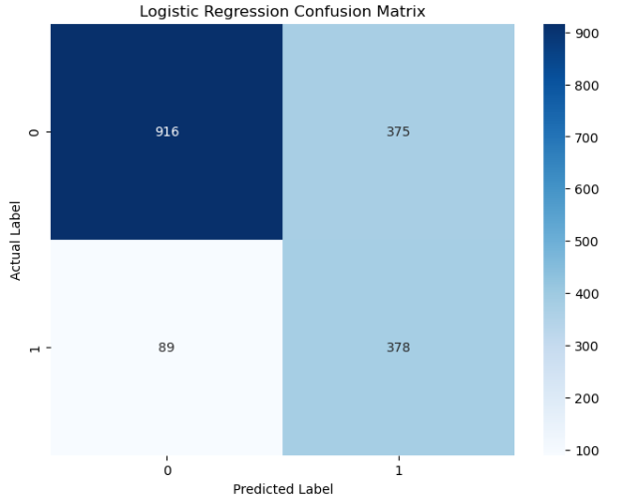
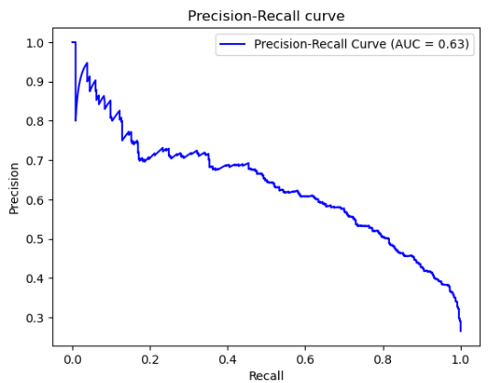
Best Model
Logistic Regression
Though the accuracy of random forest was slightly better than logistic regression but we are going to use logistic regression as the best model ,the reason is the recall and f1-score of minority class is higher ,as we want to predict customers who are churning ,logistic regression seems a good choice
Confusion Matrix
Precision Recall Curve

Slide 19
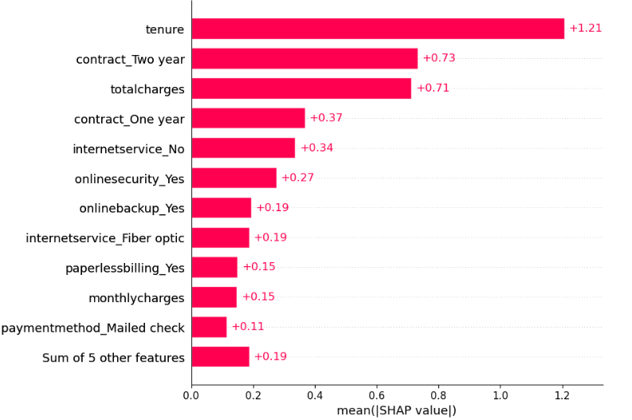
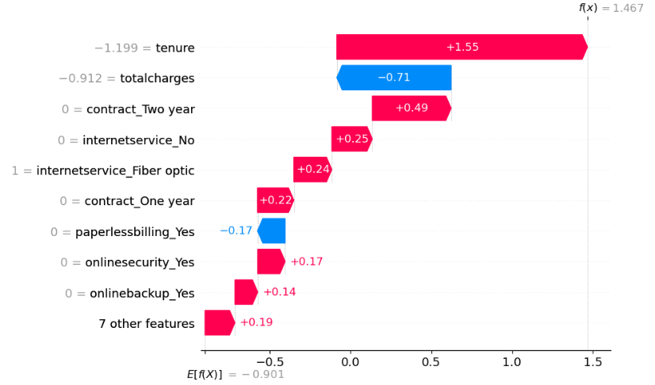
Model Interpretation
Bar Plot
Waterfall Plot
INSIGHTS:
According to the shap,the tenure,contract_two_year and total charges are the 3 most important features that drives the models prediction.
Regarding the customer services ,internetservice_no and online security_yes are the most important features.
INSIGHTS:
For the first observation,tenure has a postive impact and increased the prediction to about 1.55.
where as total charges has a negative impact and decreased the prediction to -0.71.
This indicates that this particular instance is likely to churn.

Slide 20
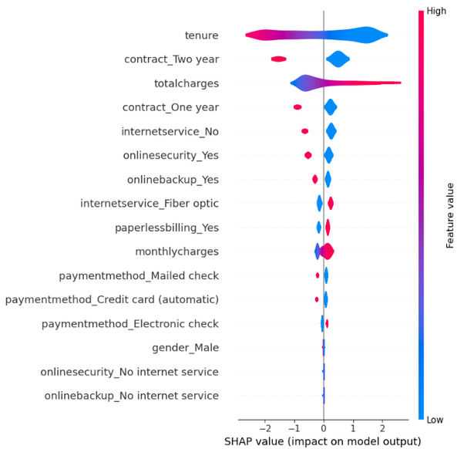
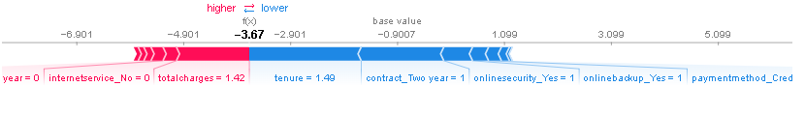
Model Interpretation
Force Plot
Violin Plot
INSIGHTS:
For the second observation ,it has been seen that total charges, contract of one year,no internet service have a positive impact.
Whereas the tenure ,online backup ,contract of two year,online security has a negative impact towards prediction.
This indicates that this particular instance is less likely to churn.
INSIGHTS:
Higher tenure reduces the chances of customer to churn .
Customers that have longer contract are less likely to churn.
Higher total Charges increases the chances of customer to churn.
Similarly higher montlhy charges also increase the likelihood of churn.

Slide 21





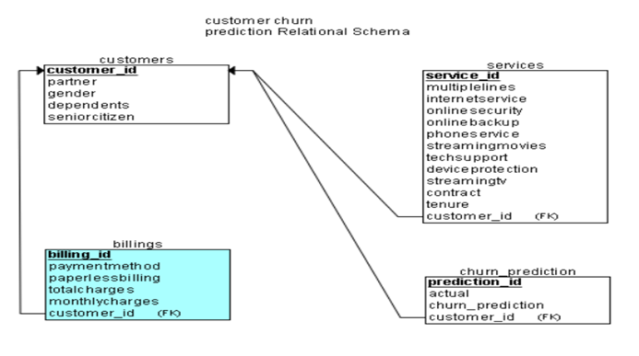

Relational Schema
1) We will make four tables :
1)Customers
2)Billings
3)Services
4)Churn prediction
We will subset the dataframes according to the columns provided in the schema.
Then insert the data in to sql.
We will then perform further analysis in sql.

Slide 22
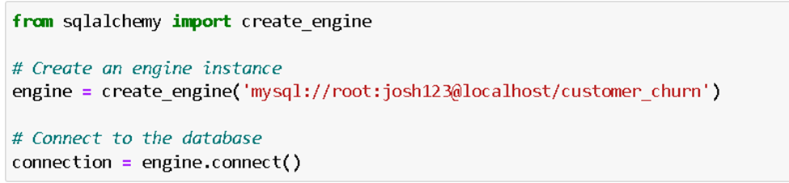
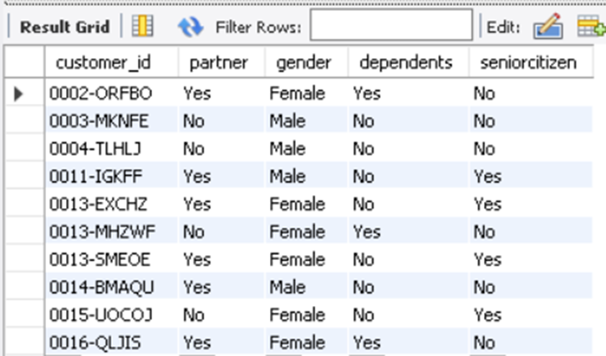
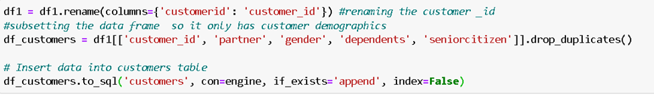
Data Ingestion
Connecting to database
Verifying through sql:
Inserting data in to Customers table:

Slide 23
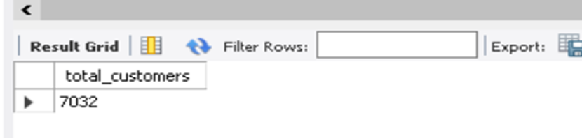
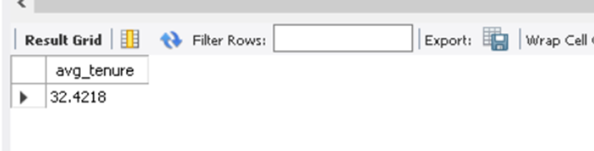
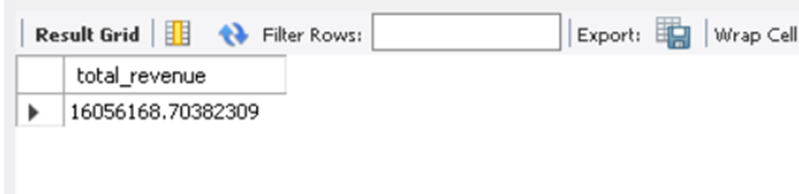
Querying through data
Displaying the total number of customers
Displaying the average tenure
Displaying the total revenue
Query:
select count(*) as total_customers from customers;
Query:
select avg(tenure) as avg_tenure from services;
Query:
select sum(totalcharges) as total_revenue from billings;
Result:
Result:
Result:

Slide 24
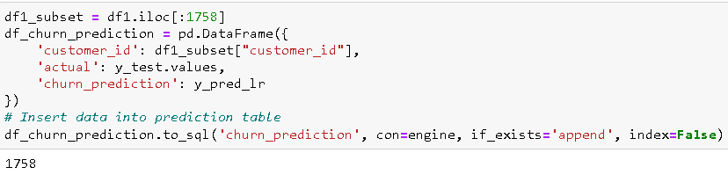
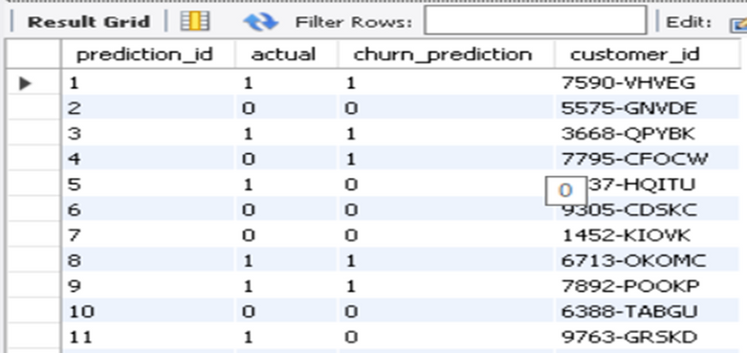
Storing Prediction
CREATE TABLE churn_prediction (
prediction_id INT NOT NULL AUTO_INCREMENT,
actual BIT NOT NULL,
churn_prediction BIT NOT NULL,
customer_id VARCHAR(50) NOT NULL,
PRIMARY KEY (prediction_id),
CONSTRAINT fk_churn_prediction_customer_id FOREIGN KEY (customer_id) REFERENCES customers(customer_id)
);
Creation of Prediction table:
Inserting Data in to sql:
Result:

Slide 25
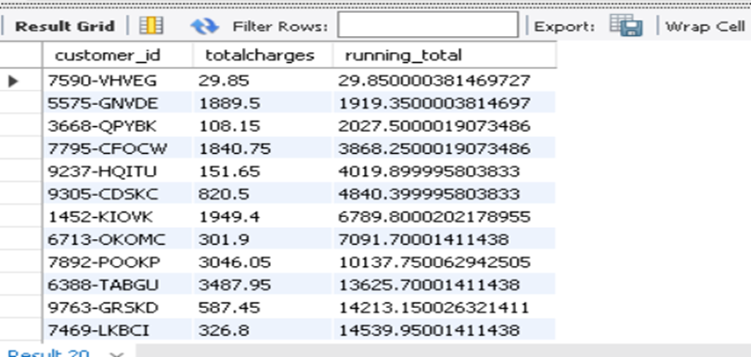
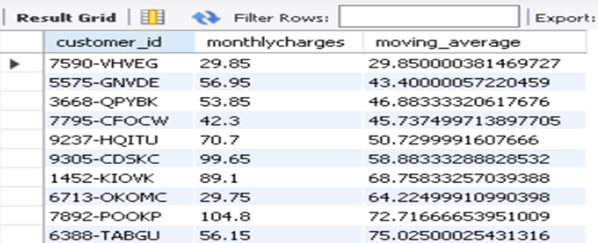
Advanced Sql Analysis
Calulcating the cummulative sum of total charges
Displaying average of monthly charges over last 5 months
Query:
select customer_id, totalcharges,
sum(totalcharges) over (order by billing_id) as running_total
from billings;
Query:
select customer_id, monthlycharges,
avg(monthlycharges) over (order by billing_id rows between 5 preceding and current row) as moving_average
from billings;
Result:
Result:

Slide 26

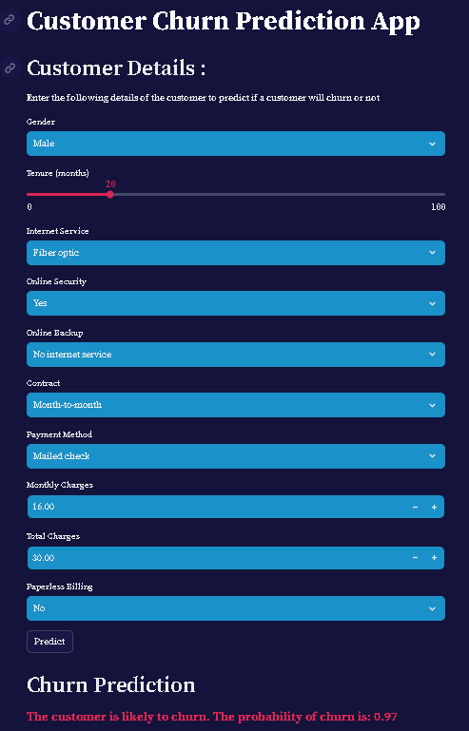
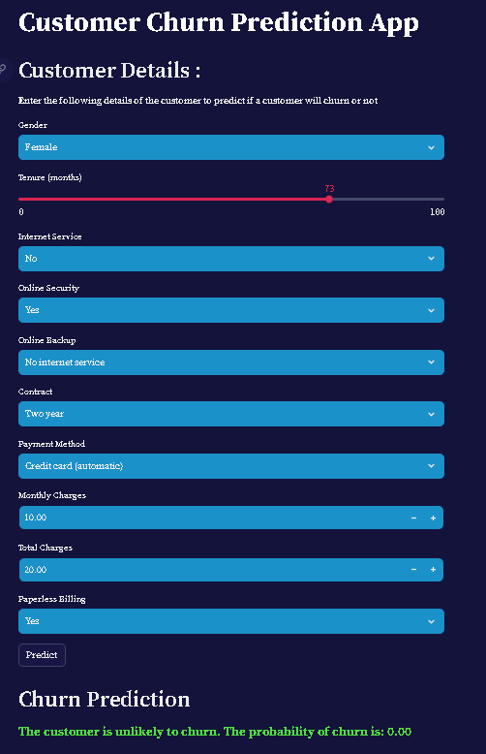
Model Deployment
Manager

Slide 27

THANK YOU

